Slide 1
SJSU CS 46A Introduction to Programming
When you come in
Open Canvas
Download Lesson08_student.zip
Unzip it
Join our class on iClicker after started

Slide 2
SJSU CS 46A Introduction to Programming
4.3 Input and Output
4.4 Problem Solving
4.5 Strings
Notes:
Sections 2.5 – 2.8

Slide 3
Java Class Scanner
Public Instance Methods
public int nextInt() Reads the next int number
public double nextDouble() Reads the next double number
public String next() Reads the next string without space
public String nextLine() Reads the next line of input including spaces (normally multiple words)

Slide 4
Par08 Problem A
import java.util.Scanner;
/**
* A Java program to input, process, and output strings.
*
* @author Qi Yang
* @version 2022-09-20
*/
public class StringProg
{
public static void main(String[] args)
{
Scanner in = new Scanner(System.in);
}
}

Slide 5
Reading an Entire Line Including Spaces
public static void main(String[] args)
{
Scanner in = new Scanner(System.in);
System.out.print("Enter multiple words separated by single spaces: ");
String line = in.nextLine();
}
//Sample input
// CS 46A in Java
//line: " CS 46A in Java "
Notes:
Input: “ CS 46A in Java “

Slide 6
Reading a Single String
public static void main(String[] args)
{
Scanner in = new Scanner(System.in);
System.out.print("Enter a single word: ");
String word = in.next();
}
//Sample input
// CS 46A in Java
// word: "CS"
Notes:
Same Input: “ CS 46A in Java “

Slide 7
Displaying Strings Within Quotes
Input for nextLine():
CS 46A in Java
Required output
The original line: " CS 46A in Java "
Input for next():
CS 46A in Java
Required output
The original word: "CS"

Slide 8
This Does NOT Work!
System.out.println("The original word: "" + word + """);
Start of string
End of string
What is this?

Slide 9
Displaying Strings Within Quotes
public static void main(String[] args)
{
Scanner in = new Scanner(System.in);
System.out.print("Enter multiple words separated by single spaces: ");
String line = in.nextLine();
System.out.println("The original line: " + line);
System.out.println("The original line within quotes: \"" + line + "\"");
}
End of string
Start of string
Quote inside string

Slide 10
The Escape Character
The escape character (back slash): \
It changes the meaning of the next character.
" the start or end of a string
\" a double quote inside string
n lowercase n
\n next line character

Slide 11
Java Class String
All methods are accessors and
will not change the string object.

Slide 12
Methods of Class String (Lesson04)
public int length()
public String toUpperCase()
public String toLowerCase()
public String replace(char oldChar, char newChar)
public String replace(String oldStr, String newStr)
public char charAt(int index)

Slide 13
More String Methods
public String trim()
public boolean contains(String str)
public String substring(int beginIndex)
public String substring(int beginIndex, int endIndex)
public int indexOf(char ch)
public int indexOf(char ch, int fromIndex)
public int indexOf(String str)
public int indexOf(String str, int fromIndex)

Slide 14
Method trim()
// The method removes spaces from both ends
// of the string, but not spaces within.
public String trim()

Slide 15
Method trim() Example
public static void main(String[] args)
{
Scanner in = new Scanner(System.in);
System.out.print("Enter multiple words separated by single spaces: ");
String line = in.nextLine();
System.out.println("The original line: \"" + line + "\"");
String lineTrimmed = line.trim();
System.out.println("The line with spaces trimmed from both ends: \"" +
lineTrimmed + "\"");
line = line.trim();
}

Slide 16
Method contains()
// The method determines if this string
// contains the parameter str and returns
// true or false.
public boolean contains(String str)

Slide 17
Method contains() Example
public static void main(String[] args)
{
Scanner in = new Scanner(System.in);
String line = in.nextLine();
String word = in.next();
boolean trueOrFalse = line.contains(word);
System.out.println("The line contains \"" + word + "\": " +
trueOrFalse);
trueOrFalse = line.contains(word.toLowerCase());
System.out.println("The line contains \"" + word.toLowerCase() +
"\": " + trueOrFalse);
}

Slide 18
Overloading Method substring()
// Returns the substring from beginIndex to the end.
public String substring(int beginIndex)
// Returns a string that is a substring of this string. // The substring begins at the specified beginIndex and
// extends to the character at index endIndex - 1.
// Thus, the length of the substring is
// endIndex – beginIndex.
public String substring(int beginIndex, int endIndex)

Slide 19
Method substring() Examples
String course = "CS 46A";
System.out.println(course.substring(1));
// Output: S 46A
System.out.println(course.substring(1, 2));
// Output: S
System.out.println(course.substring(1, 4));
// Output: S 4
// Run time error!
System.out.println(course.substring(-1, 3));
C | S |  | 4 | 6 | A
0 | 1 | 2 | 3 | 4 | 5
index

Slide 20
iClicker Question #1
String courseTitle = "Introduction to Programming";
int index = 5;
int size = 3;
Which expression returns the substring of size 3 starting at index 5?
A. courseTitle.substring(index, index + size)
B. courseTitle.substring(index, index + size + 1)
C. courseTitle.substring(index, index + size - 1)
D. None of the above

Slide 21
String courseTitle = "Introduction to Programming";
int index = 5;
int size = 3;
Which expression returns the substring of size 3 starting at index 5?
A. courseTitle.substring(index, index + size)
B. courseTitle.substring(index, index + size + 1)
C. courseTitle.substring(index, index + size - 1)
D. None of the above
I | n | t | r | o | d | u | c | t | i | …
0 | 1 | 2 | 3 | 4 | 5 | 6 | 7 | 8 | 9 | …

Slide 22
Method substring()
// Returns a string that is a substring of this string. // The substring begins at the specified beginIndex and
// extends to the character at index endIndex - 1.
// Thus, the length of the substring is
// endIndex – beginIndex.
public String substring(int beginIndex, int endIndex)
A. courseTitle.substring(index, index + size)

Slide 23
Overloading Method indexOf()
public int indexOf(char ch)
public int indexOf(char ch, int fromIndex)
public int indexOf(String str)
public int indexOf(String str, int fromIndex)

Slide 24
Method indexOf()
public static void main(String[] args)
{
Scanner in = new Scanner(System.in);
String line = in.nextLine();
String word = in.next();
String lineTrimmed = line.trim();
int pos = line.indexOf(word);
System.out.println("The index of the word in the original line: " + pos);
pos = lineTrimmed.indexOf(word);
System.out.println("The index of the word in the trimmed line: " + pos);
}
Search from the beginning of the string and returns the index of the first occurrence of word. The method returns -1 if not found.
Notes:
Line: CS 46A in Java
Word: Java

Slide 25
String Index Starts at Zero
String line:
String word: Java
String lineTrimmed:
 |  | C | S |  | 4 | 6 | A |  | i | n |  | J | a | v | a
0 | 1 | 2 | 3 | 4 | 5 | 6 | 7 | 8 | 9 | 10 | 11 | 12 | 13 | 14 | 15 | 16 | 17
C | S |  | 4 | 6 | A |  | i | n |  | J | a | v | a
0 | 1 | 2 | 3 | 4 | 5 | 6 | 7 | 8 | 9 | 10 | 11 | 12 | 13 | 14 | 15 | 16 | 17

Slide 26
iClicker Question #2
String line = in.nextLine();
String lineTrimmed = line.trim();
int pos = lineTrimmed.indexOf(' ');
Which of the following prints out the first word of the trimmed line without spaces?
System.out.println(lineTrimmed.substring(0, pos));
System.out.println(lineTrimmed.substring(0, pos + 1));
System.out.println(lineTrimmed.substring(0, pos - 1));
None of the above

Slide 27
Finding the First Word
public static void main(String[] args)
{
Scanner in = new Scanner(System.in);
String line = in.nextLine();
String word = in.next();
String lineTrimmed = line.trim();
int pos = lineTrimmed.indexOf(' ');
System.out.println("First word of the trimmed line: \"" +
lineTrimmed.substring(0, pos) + "\"");
}
Substring from index 0 to pos – 1: substring(0, pos)

Slide 28
Finding the Second Word
public static void main(String[] args)
{
Scanner in = new Scanner(System.in);
String line = in.nextLine();
String word = in.next();
String lineTrimmed = line.trim();
int pos = lineTrimmed.indexOf(' ');
int secondSpace = lineTrimmed.indexOf(" ", pos + 1);
System.out.println("Second word of the trimmed line: \"" +
lineTrimmed.substring(pos + 1, secondSpace) + "\"");
}

Slide 29
First Word and Second Word
pos
secondSpace
C | S |  | 4 | 6 | A |  | i | n |  | J | a | v | a
pos = lineTrimmed.indexOf(' ‘);
// First word: lineTrimmed.substring(0, pos)
secondSpace = lineTrimmed.indexOf(" ", pos + 1);
// Second word: lineTrimmed.substring(pos + 1,
secondSpace)

Slide 30
Formatted Output
Class FormattedOutput in Lesson08_Examples
Notes:
Method printf() of System.out

Slide 31
Method printf() of System.out
System.out.printf(param1, param2, ...)
The first parameter is the string to be displayed with values specified by format specifiers
Each format specifier starts with a %
Other parameters provide the values and will be inserted into the output string after formatted
It does not go to next line

Slide 32
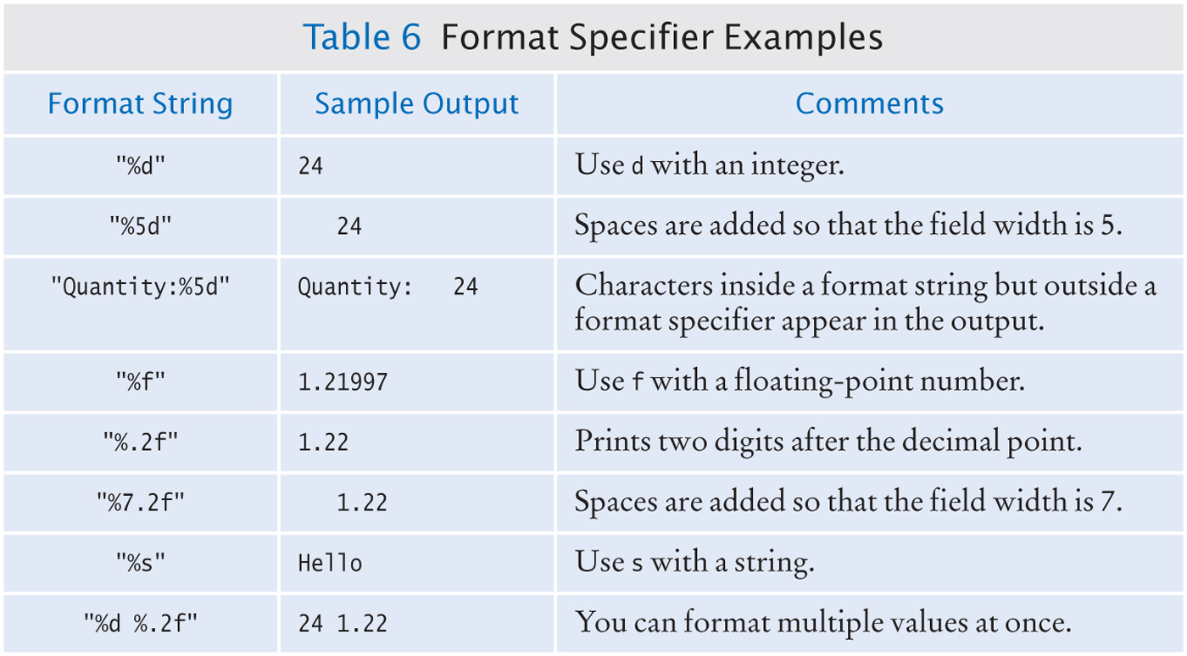
Notes:
%f: double, float values

Slide 33
Formatted Output
int intNum = in.nextInt(); // 5
System.out.println("The input integer is " +
intNum + ".");
The input integer is 5.
(go to next line)
System.out.printf("The input integer is %d.",
intNum);
The input integer is 5.
Format specifier
(stay on the same line)

Slide 34
Formatted Output and Next Line
System.out.println("The input integer is " +
intNum + ".");
The input integer is 5.
(go to next line)
System.out.printf("The input integer is %d.%n",
intNum);
%n: go to next line
Same output and go to next line
Format specifier
Format specifier

Slide 35
Formatted Output and Next Line
System.out.printf("The input integer is %d.%n",
intNum);
System.out.printf("The input integer is %d.\n",
intNum);
\n: Escape sequence
Can be used without printf()
%n: Format specifier
Can only be used with printf()
The period at the end

Slide 36
Formatted Output
System.out.println("The square root of " + intNum +
" is " + Math.sqrt(intNum) + ".");
The square root of 5 is 2.23606797749979.
System.out.printf("The square root of %d is %f.%n",
intNum, Math.sqrt(intNum));
The square root of 5 is 2.236068.
System.out.printf("The square root of %d is %.2f.%n",
intNum, Math.sqrt(intNum));
The square root of 5 is 2.24.
System.out.printf("The square root of %d is %7.2f.\n",
intNum, Math.sqrt(intNum));
The square root of 5 is 2.24.
Notes:
Default length for %f: 6

Slide 37
iClicker Question #3
String name = in.nextLine(); // iPhone 11
double price = in.nextDouble(); // 749.99
double discRate = in.nextDouble(); // 0.1 for 10%
double discPrice = price * (1 – discRate);
Assuming the calculation is correct, which statement displays the following message?
The discount price for iPhone 11 is $674.99.
A. System.out.printf("The discount price for %s is %.2f.\n",
name, discPrice);
B. System.out.printf("The discount price for %s is $%.2f.\n",
name, discPrice);
C. Both A and B
D. Neither A nor B
Notes:
Million
Trillion

Slide 38
Display Numbers Only
final int COUNT_OF_NUMBERS = 3;
int sum = 10;
System.out.printf("%7d.%n", sum);
System.out.printf("%7.2f.\n",
(double)sum / COUNT_OF_NUMBERS);
Output
10.
3.33.

Slide 39
Participation Exercise Par08
Par08_A:
www.codecheck.it/files/21022201422mcxzqdsm6gsyi02zvkux619e
Par08_B:
www.codecheck.it/files/2006252353a5ns5nfvr4rjry8n66s5utwsd

Slide 40
Stay in the Main room
Par07 Solutions
Breakout Rooms 1 or 2
Ask SI Leaders any questions
My Office Hours
8 – 9 pm

